Slide 1
CHAPTER 1
HUMAN INQUIRY AND SCIENCE

Slide 2
Some questions
What is the capital of the US?
What language is primarily spoken in Japan?
What temperature does water freeze at?
How do you know all these things are true?

Slide 3
Acquiring Information
Tenacity:
  Information accepted as true because it has always been believed or because superstition supports it.
  Limitations: potential inaccuracies; no method for correcting erroneous ideas.

Slide 4
Acquiring Information
Intuition
  Information accepted based on a hunch.
  Problem?
    Limitation: no method for separating accurate from inaccurate knowledge.

Slide 5
What about Authority?
Information or answers from an expert in the field.
Good starting point—often quickest and easiest way to obtain answers.
Problem?

Slide 6
What about Authority?
Some limitations:
  Does not always provide accurate information.
  Often accepts expert’s statements as fact (method of faith).
  Not all “experts” are experts.

Slide 7
The Rational Method
Seeking answers by logical reasoning:
  All 3-year-old children are afraid of the dark.
  Amy is a 3-year-old girl.
  Therefore, Amy is afraid of the dark.
In the above argument:
  First two sentences are premise statements;
  Final sentence is a logical conclusion based on the premises.

Slide 8
Limitations to the Rational Method
Only valid if the premise statements are true!
  The rational method “assumes” the premise statements are true.
People are not very good at logical reasoning.
  Sometimes the argument does not logically support the conclusion.

Slide 9
The Empirical Method
Also known as empiricism: answering questions by direct observation or personal experience.
  Based on the philosophy that all knowledge is acquired through the senses.
  Observation is key!

Slide 10
Science and knowledge
Science is based on empiricism
  Goal of science is to produce knowledge through discovery
  Knowledge is acquired via scientific method

Slide 11
Three Important Principles of the Scientific Method
It is empirical
It is public
It is objective

Slide 12
Science is Empirical and Public
Empirical: Based on structured or systematic observations.
Public: Observations are available for evaluation by others.
  Replication is key to the scientific method!
Objective: Outcome is not skewed by bias.

Slide 13
Science and knowledge
Science is based on empirical discovery but…
  most of what YOU know isn’t from personal discovery!
Your knowledge reflects agreement and belief
  Reliance on experts

Slide 14
Tradition
Derived from culture
  Contains firmly accepted knowledge about the working of the world
  Advantages?
    Inherited knowledge means we aren’t starting from scratch
  Disadvantages?
    Challenging tradition can be problematic

Slide 15
Authority
Accepting new knowledge as truth depends on status of the discoverer
  Example: More likely to believe an expert than your uncle
Problems with relying on experts?
  What if they are outside their area of expertise?

Slide 16
Other Problems With Authority: Pseudoscience
Pseudoscience is a system of ideas often presented as science.
  Lacks some of the key components essential to scientific research.
  Examples: aromatherapy, astrology, etc.

Slide 17
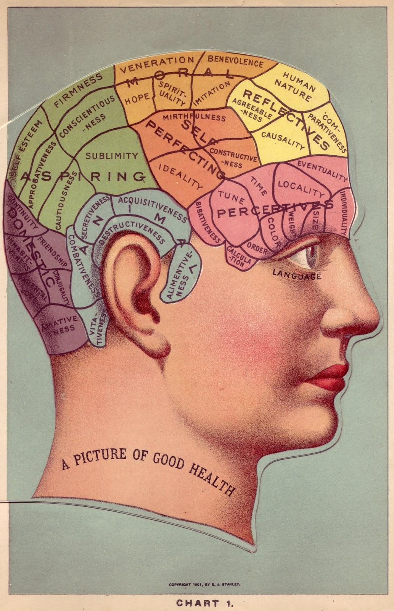
Phrenology (1)
Phrenology: Behavior is housed in specific areas of the brain
  Behavior-structure mapping
  Indentations in your scalp indicate abilities you possess
Franz Joseph Gall (1758 – 1828)

Slide 18
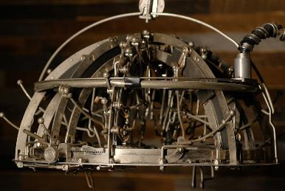
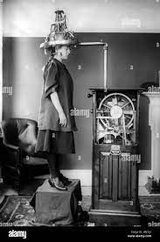
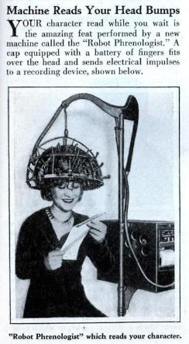
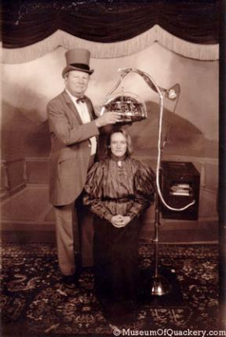
Phrenology (2)
Persisted into the 20th Century!

Slide 19
Potential Problems w/ Observation
Inaccurate Observations
  Is the measurement device accurate?
  Validity == measuring what its suppose to?
  Reliability == same measurement each time?

Slide 20
Potential Problems w/ Observation
Overgeneralizations: Are the conclusions we’re making too broad?
  Large and representative samples help with this!
How to account for potential errors?
  Replication – Repeating a research study to test and either confirm or question the findings of an earlier study.

Slide 21
Other Problems
Limitations:
  Observations can be misinterpreted
  Time-consuming
  Sensory experience can be swayed by beliefs.
    Biased thinking!

Slide 22
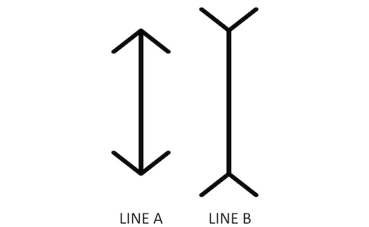

Slide 24
Other Problems
Sensory experience can be swayed by beliefs.
  Biased thinking!
Especially when something is ambiguous!

Slide 25

Subjective Observations

Slide 26
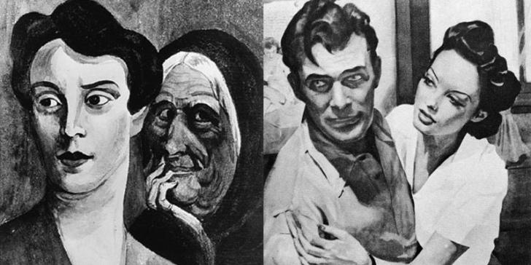
Subjective Observations

Slide 27
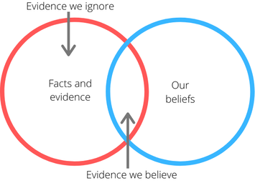
Cognitive Biases
Confirmation bias == tendency to interpret new evidence as confirmation of one’s existing beliefs or theories

Slide 28
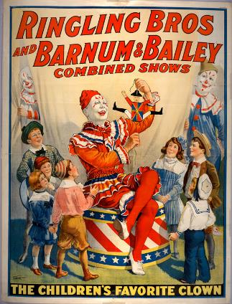
Example: The Barnum Effect
People believe that general descriptions are accurate and directly relate to them.
Super common with:
  Horoscopes
  Fortune telling
“A sucker is born every minute” – P. T. Barnum

Slide 29
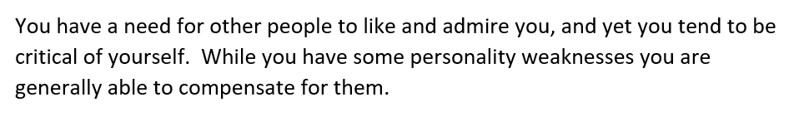
The Barnum Effect
Based on vague statements!
People tend to agree with statements like this!
**Mean rating: 4.2/5 (range: 3 - 5)**

Slide 30
Psychology’s Scientific Method
The foundations of social science are logic and observation.
  Any understanding of the world must make sense and must correspond with what we observe!
Observations == data!
Data informs theory!
Theory == logical explanation based on observed data!

Slide 31
Scientific Method (2)
Observe/
Question
Hypothesis
Experiment/
Test Hypothesis
Analyze Results
Form Conclusions
Theories are part of the observing/ questioning stage.
Collect data here!

Slide 32
Psychology as a Science
Psychological Science = Theory + Data Collection + Data analysis
Analysis vs collection?
  Collection == experiment or observation
  Analysis == finding patterns in the data

Slide 33
Psychology as a Science
Often deal w/ Aggregates, Not Individuals
  The collective actions and situations of many individuals.
  Explain why aggregated patterns of behavior occur even if individuals might differ.
  How do individuals in general behave?

Slide 34
How do we describe observations?
Attributes = Characteristics or qualities that describe an object
  Examples: male, professor, 30, American, etc.
Variables = Groupings of attributes (think categories)
  Examples: gender, occupation, age, nationality, etc.
Attributes exist at individual level, variables at group level!

Slide 35
Relationship between variables
  Independent Variable – A variable that is manipulated by a researcher
    Example: Drug group (control vs. treatment)
  Dependent Variable – A variable assumed to depend on or be caused by another.
    Example: Health outcome
    This is what’s measured/observed! This is your data!

Slide 36
Types of data
Qualitative vs Quantitative Data
  Qualitative Data – non-numerical data
    Examples?
  Quantitative Data – numerical data
    Examples?

Slide 37
So what’s the point?
The Purposes of Research
  Mapping out a topic that may warrant further study later (exploratory)
  Describing situations (descriptive)
  Providing reasons for phenomena, in terms of causal relationships (explanatory)

Slide 38
What’s next?
Research topic (due 1/30)
Broad area → Specific question
Example: Interested in memory → Does mood affect memory
Needs to specific and testable!

